Slide 1
Lane Detection
CS 763 Project
Group members:
Ashutosh Mulchandani (200100037)
Desai Utsav Manojkumar (200100054)
Rushi Chavda (20D100007)

Slide 2
Member Contributions
Ashutosh(100 %)
Deciding the topic
Indepth Research
Code Implementation
Utsav(100 %)
Deciding the topic
Indepth Research
Code Implementation
Rushi(100 %)
Indepth Research
Data Preprocessing
Code Implementation

Slide 3
Detailed Problem Statement
Nowadays, Self driving cars are very popular around the world. One major component of it is lane detection, as it provides the layout of road and position of vehicles which is crucial for navigation. We have used LLDNet model for our work. We observed that the model doesn’t give proper output when the resolution of the images is low, or the illumination is too low in the night images.
Links to original paper: LLDNet

Slide 4
LLDNet
Basic Introduction to original paper

Slide 5
Introduction to LLDNet
Lane detection can be considered a semantic which classifies “Lane” and “Non Lane” pixels into two groups. In this work, we proposed attention-based encoder-decoder architecture, namely LLDNet, for detecting road lanes in real-time.

Slide 6
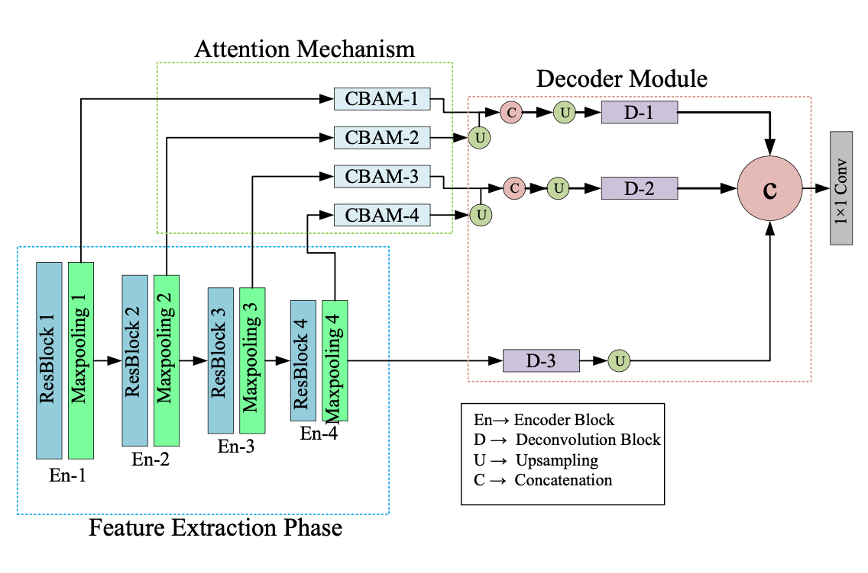
Model Architecture

Slide 7
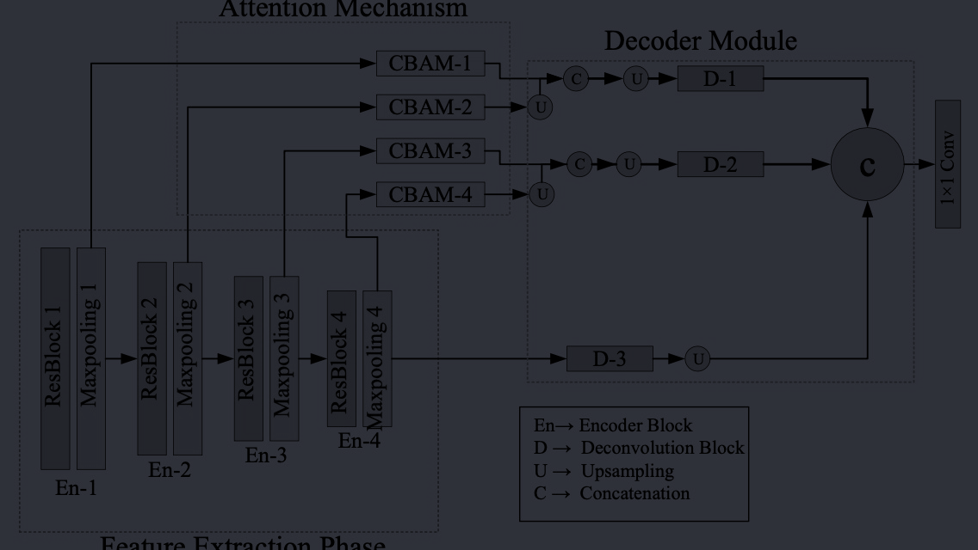
Sample Outputs
Next are some sample predictions of LLDNet

Slide 8
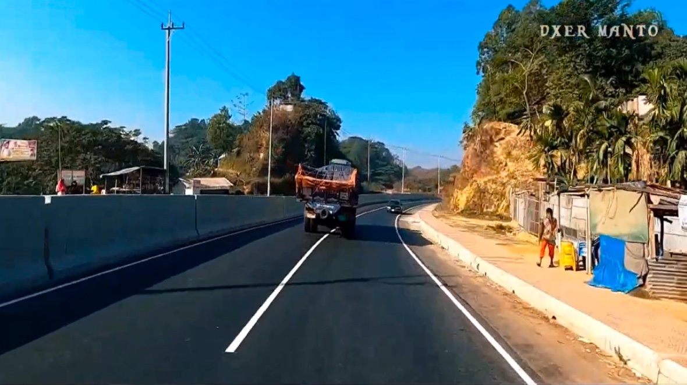
Sample 1:Daylight

Slide 9
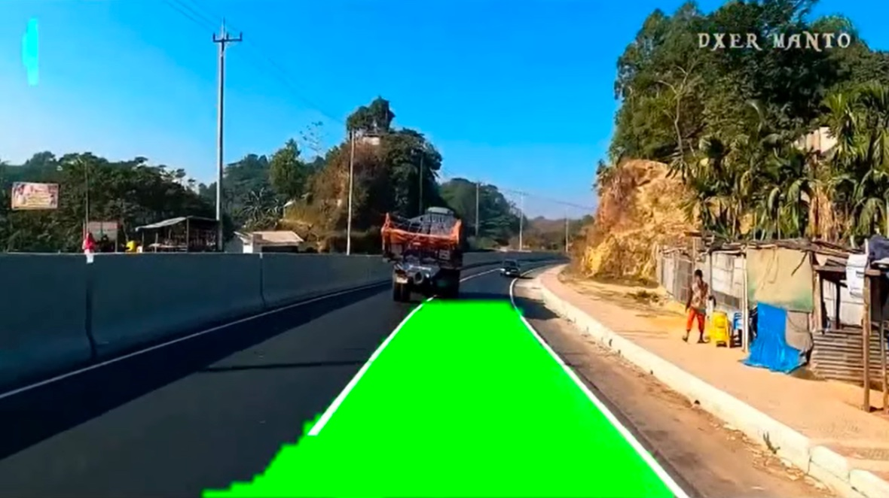
Model Output

Slide 10
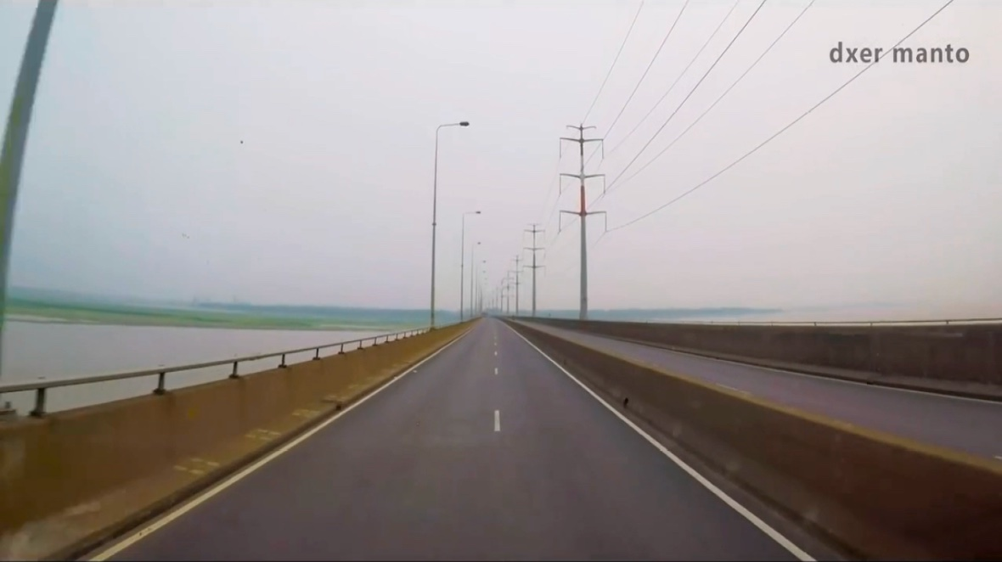
Sample 2: Cloudy

Slide 11
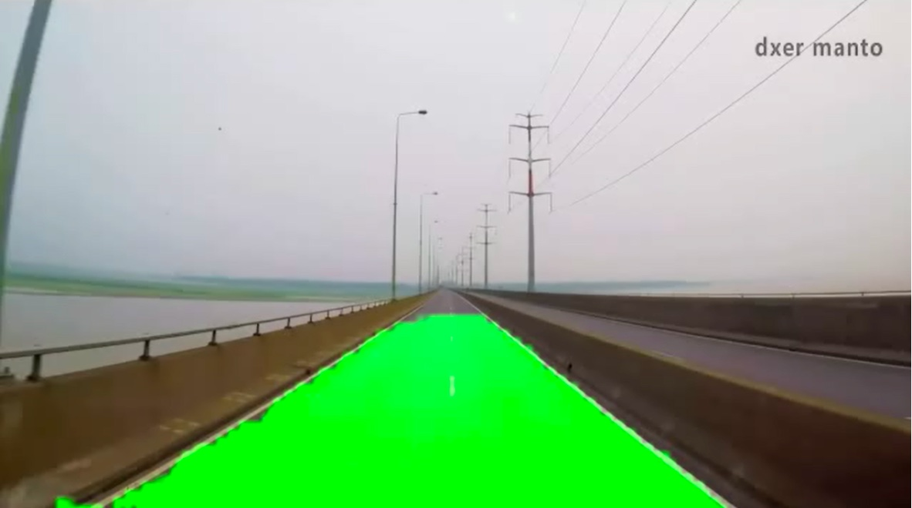
Model Output

Slide 12
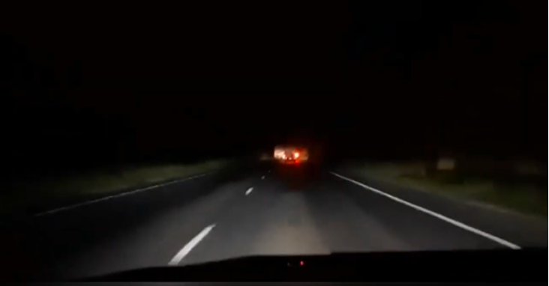
Sample 3: Night

Slide 13
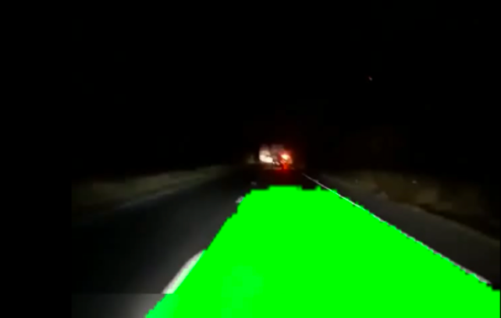
Model Output

Slide 14
Issues in original work
We observed that the original model didn’t gave proper out for low resolution images.
Also, for night images, if the illumination is too low, the prediction is erroneous sometimes.
We have shown these issues in coming slides…

Slide 15
What we did
Image Preprocessing
Histogram Equalization
Morphological operation : Opening
Sharpening

Slide 16
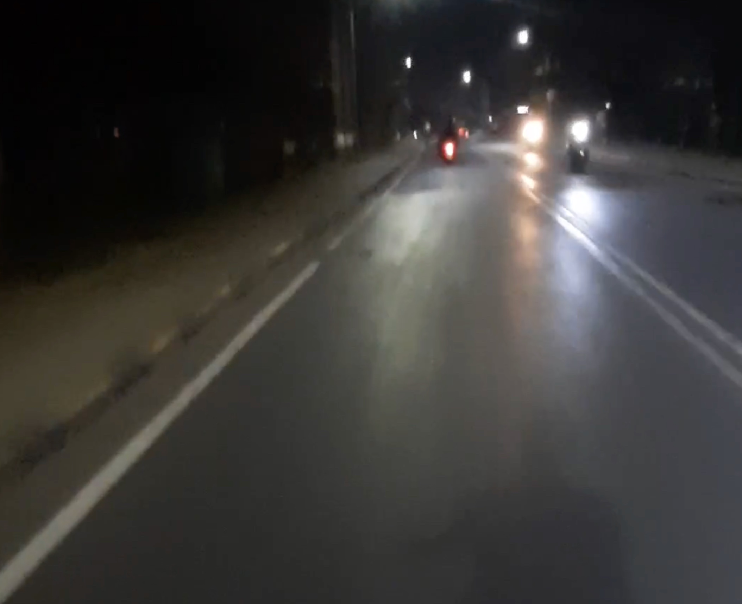
Sample:Night

Slide 17
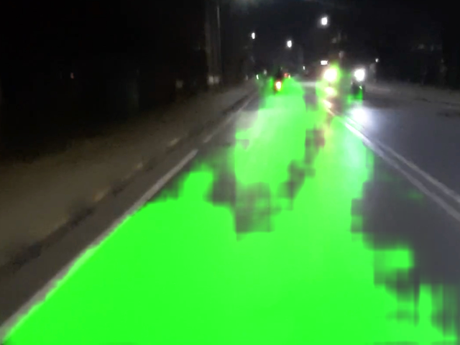
Original Model Output

Slide 18
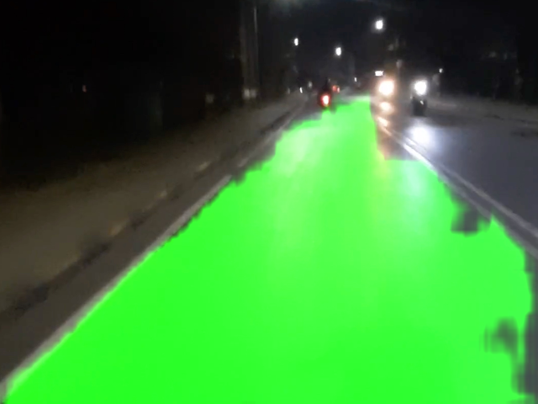
Output after Preprocessing

Slide 19
What we did
Dataset Augmentation:
Noise addition
Gamma correction (gamma = 0.8)
Horizontal flip
After augmentation, we trained the original model further on the new dataset.
Hyperparameters:
Epochs: 100
Learning rate: 0.001
Batch Size: 64
Next we will be showing what improvements we got after these alterations.

Slide 20
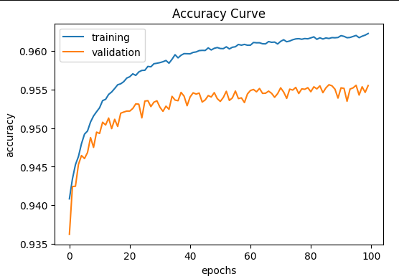
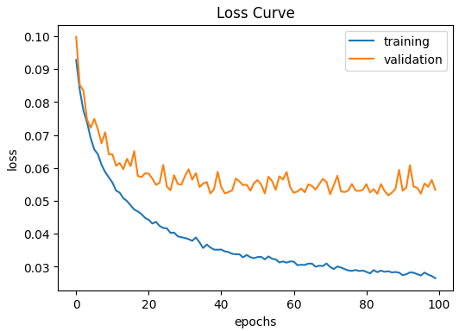
Accuracy and Loss

Slide 21
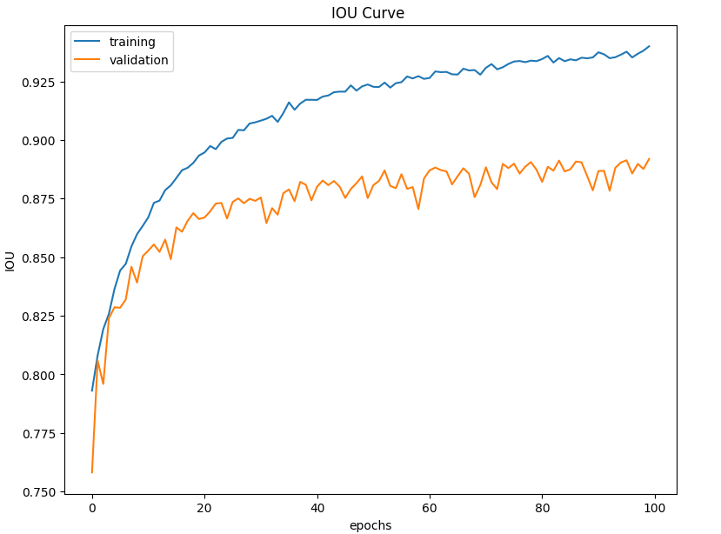
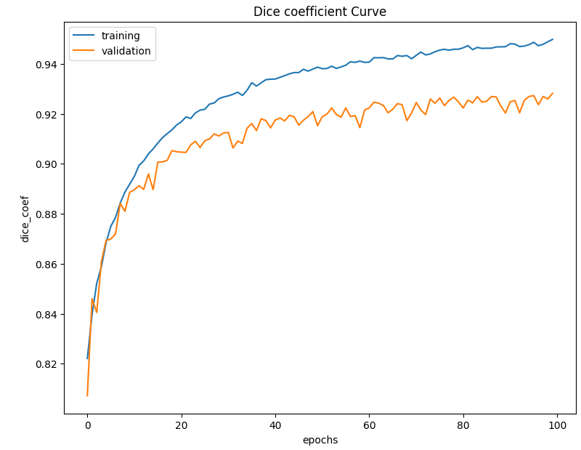
Other Metrics

Slide 22
Further Improvements
Due to Computational Limitations we limited our self in terms of number of images
The model architecture could be improved or changed
The image augmentation techniques could be further improved using wavelet transform techniques.
Fine-grained lane marking classification: LLDnet could be improved by incorporating fine-grained lane marking classification.
Robustness to lane marking variations: LLDnet could be improved to handle variations in lane markings, such as faded or partially occluded lane markings, which are common in real-world road scenarios.

Slide 23
Videos: Original Video
https://drive.google.com/file/d/1DWb4THb3XlXZvodMxmFjgqFSoj-cxrOQ/view?usp=sharing

Slide 24
Videos: Output Video after preprocessing
https://drive.google.com/file/d/1V_93R9VPBidnkh9yxk4rwIMtM1SERtnf/view?usp=sharing

Slide 25
Videos: Original Video
https://drive.google.com/file/d/1ERW_5PisQd3impTFyMd3s6-q6GwZNqik/view?usp=sharing

Slide 26
Videos: Output Video after preprocessing
https://drive.google.com/file/d/1J41anjulQ6ByBVslgk2qu02nT8BUX6D2/view?usp=sharing

Slide 27
References References
Original Paper: https://www.mdpi.com/1424-8220/22/15/5595
Augmentation: http://cs230.stanford.edu/projects_winter_2021/reports/70649396.pdf
OpenCV Documentations

Slide 28
Self Assessment
We said we will work on CLRNet but we changed to LLDNet, due to lack of resources, computation time, and large dataset.
But the main problem statement is same except the base model is different.

Slide 29
THANK YOU

